Slide 1
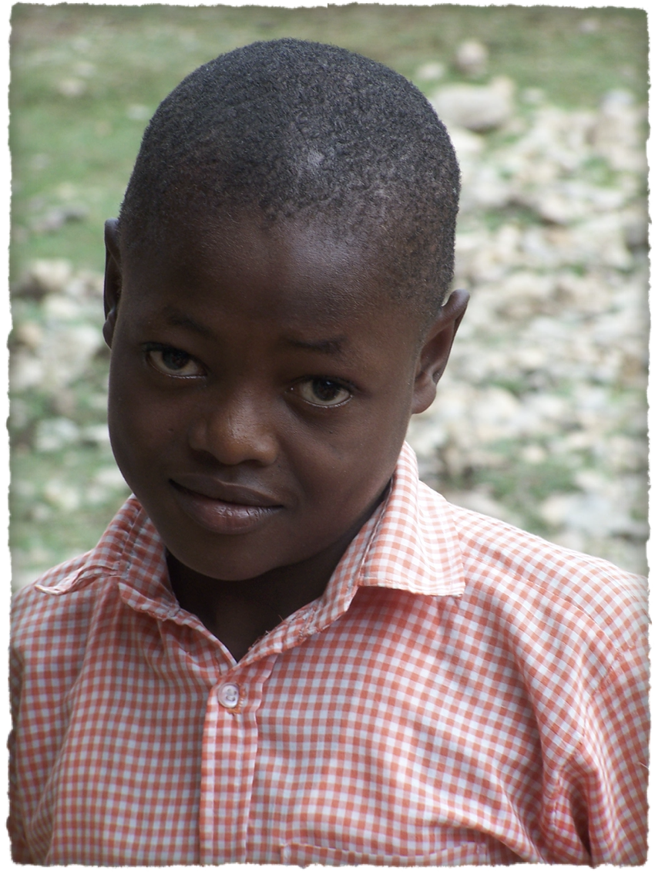
St. Thomas à Becket Haiti Mission
In solidarity with our Friends in Bercy since 2010

Slide 2
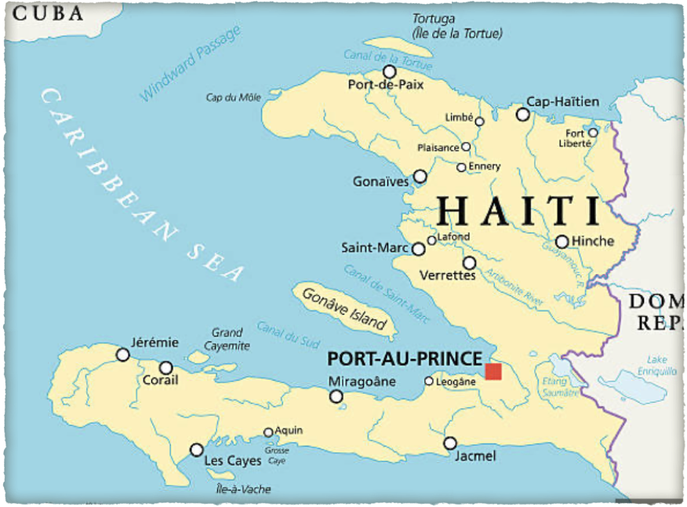
Where in the World is Bercy?

Slide 3
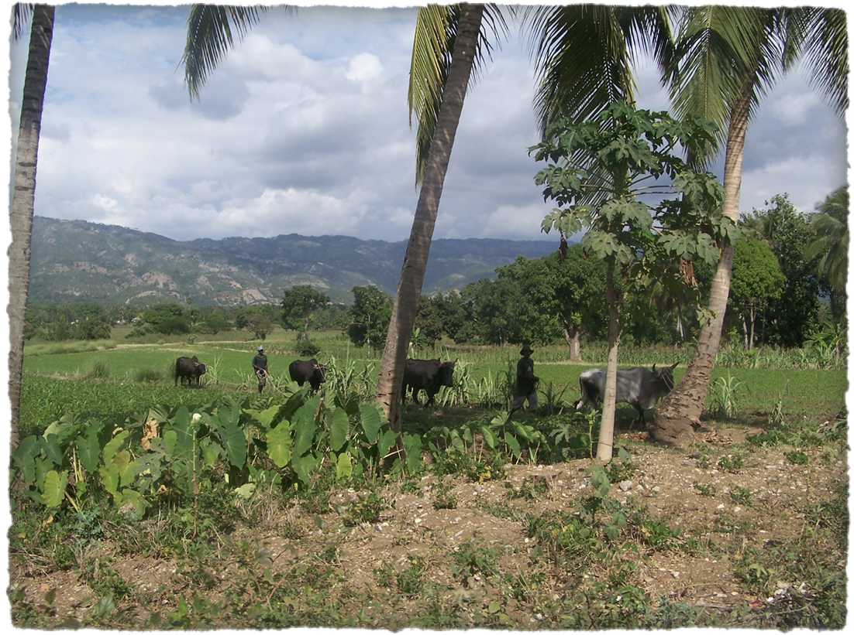
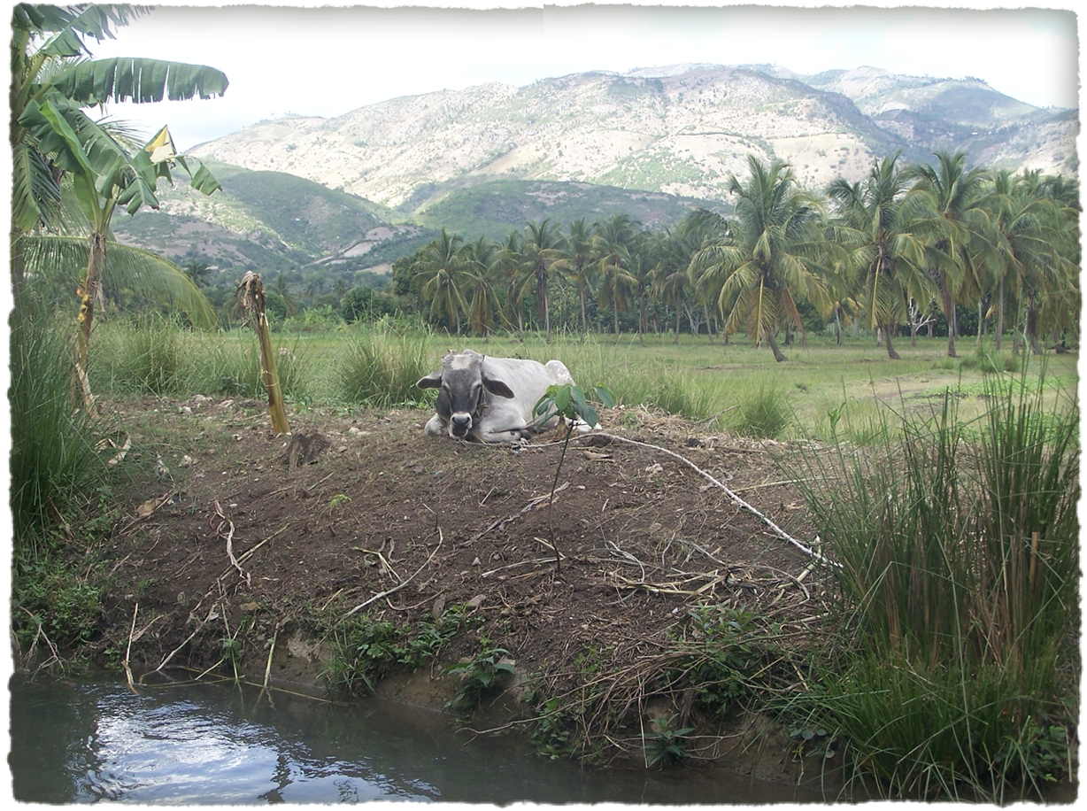
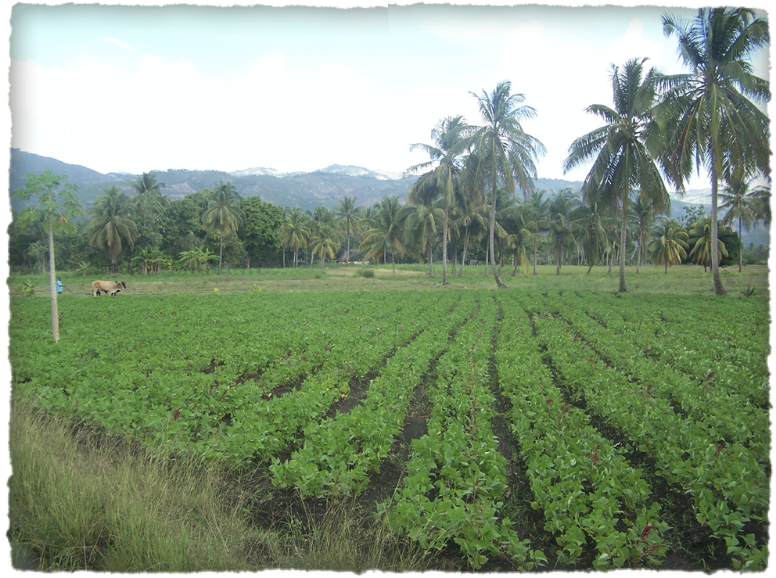
Bercy is a small farming community, a one-hour drive from the next largest town, Cavaillon

Slide 4
What is Our Mission in Bercy?
Support students & operations for parochial elementary school
Tuition support
Teacher salaries
Hot lunch program
School books and supplies - when funds are available
Planned “special projects” to help with one-time needs
School infrastructure improvements - new classrooms, administrative office, kitchen, well, latrines
Hygiene initiatives - clean water, hand washing, hygiene education in school
Garden program for school lunches
Help Bercy graduates continue studies at Notre Dame high school in Cavaillon
Emergency assistance following natural disasters

Slide 5
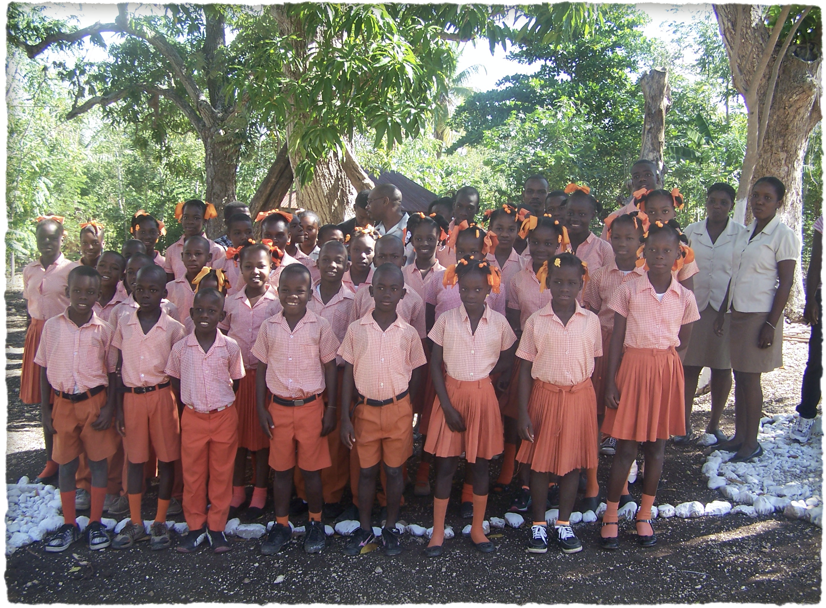
Welcome to the Bercy School
~300 students in pre-K through grade 8

Slide 6
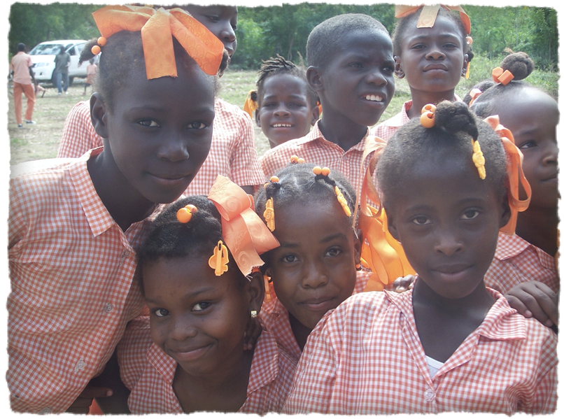
Kindergarten classrooms and school office
Grades 1-6 classrooms

Slide 7
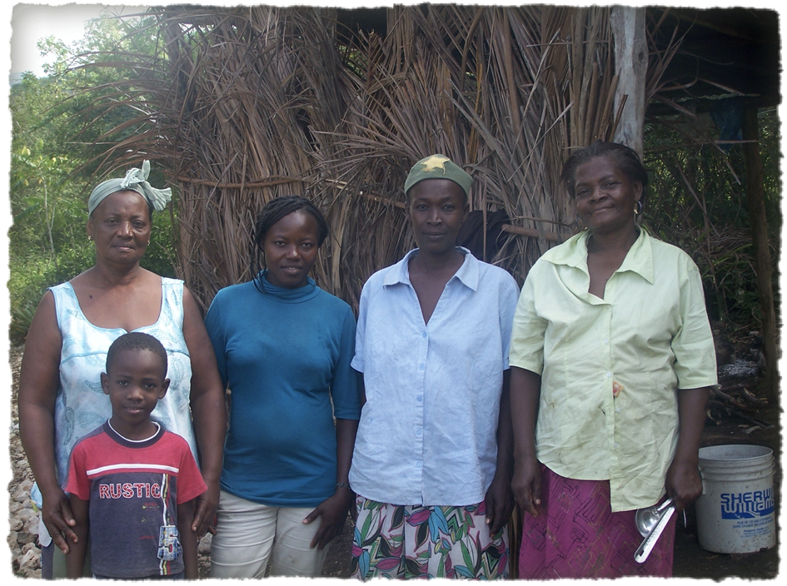
Our wonderful teachers and kitchen staff
Eager students with their school books

Slide 8
Lunch is rice and beans,
cooked over charcoal fires

Slide 9
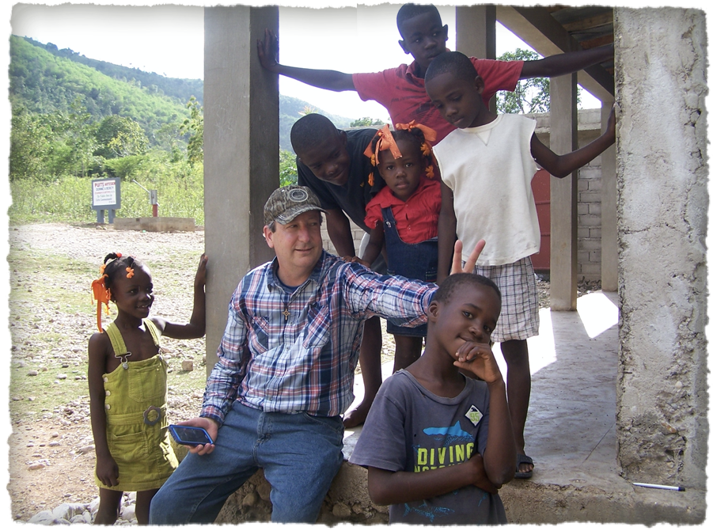
It wasn’t all work
on the mission trips
Do the hokey-pokey and you turn yourself around…

Slide 10
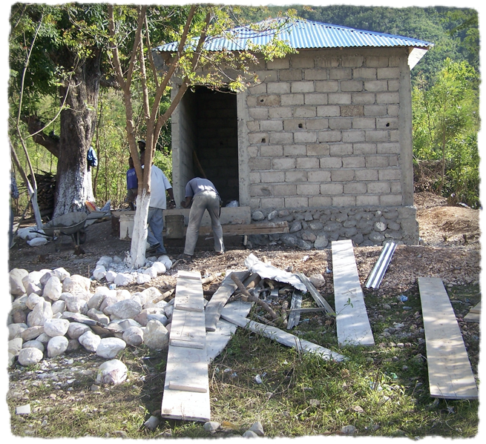
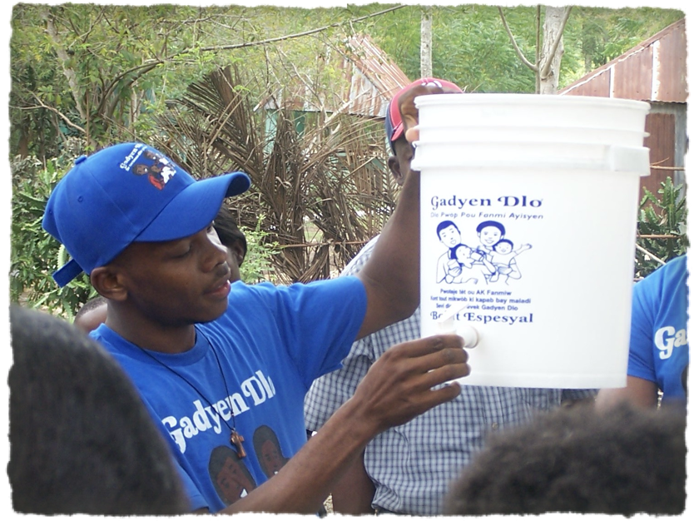
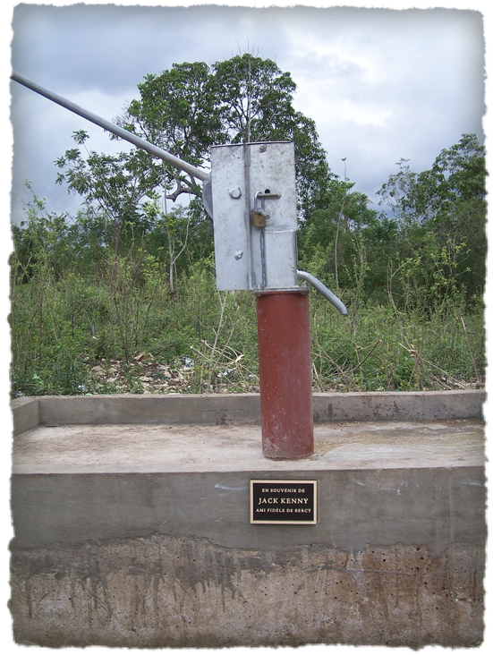
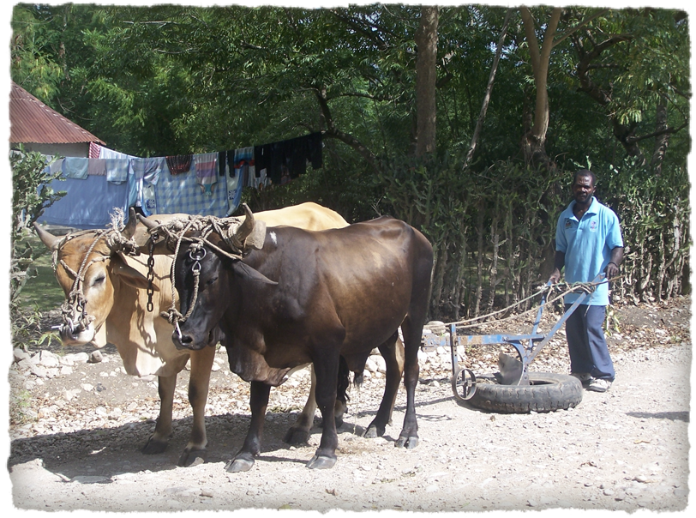
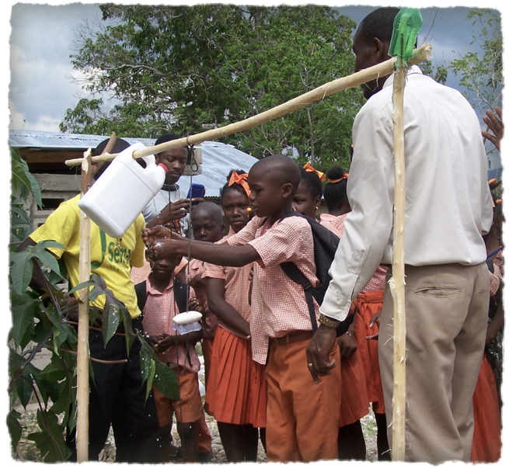
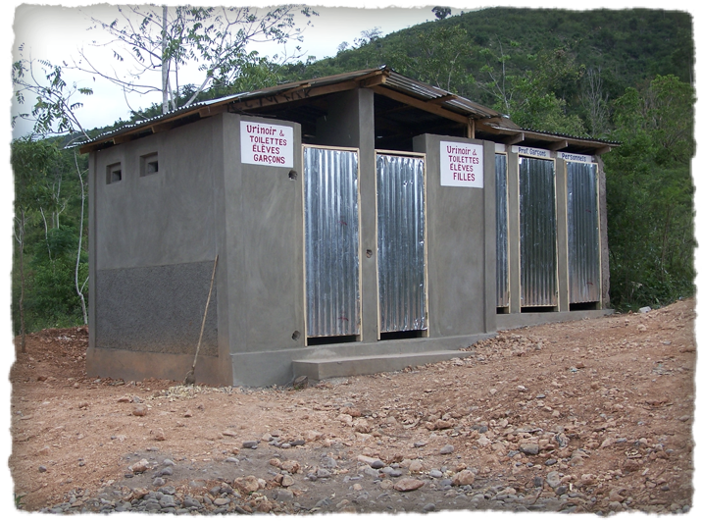
Special Projects
Over the Years
A new kitchen
Clean water
A new well
School garden
Hand washing stations
Latrines

Slide 11
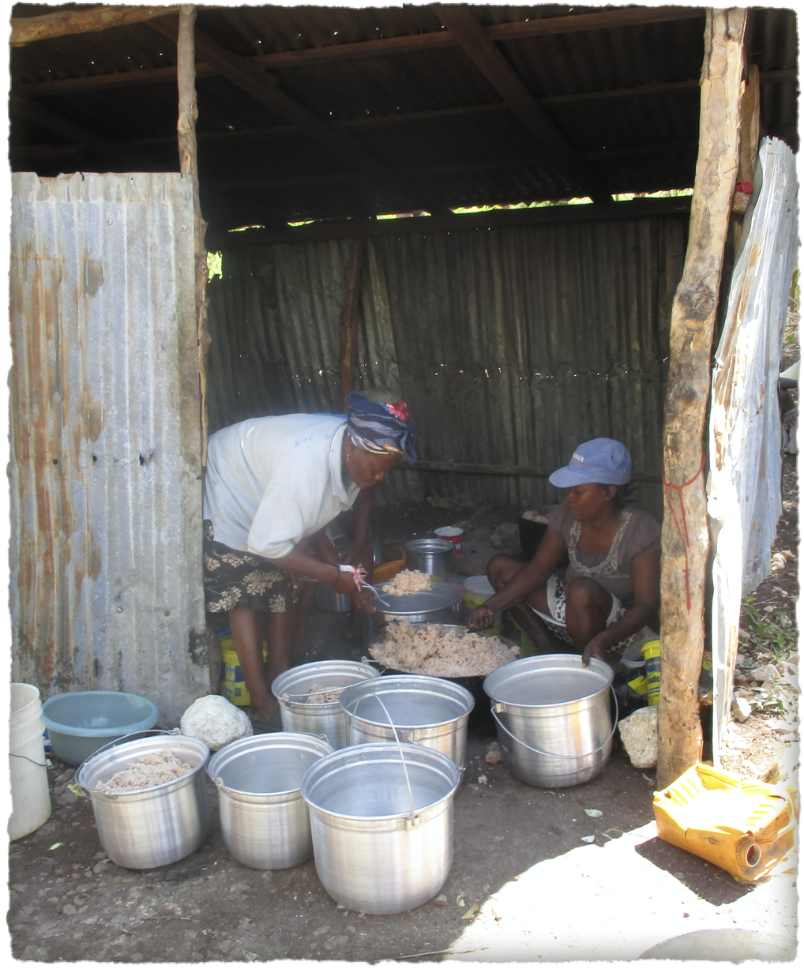
New Kitchen and New Pots

Slide 12
Teamwork needed to carry the food back to classrooms

Slide 13
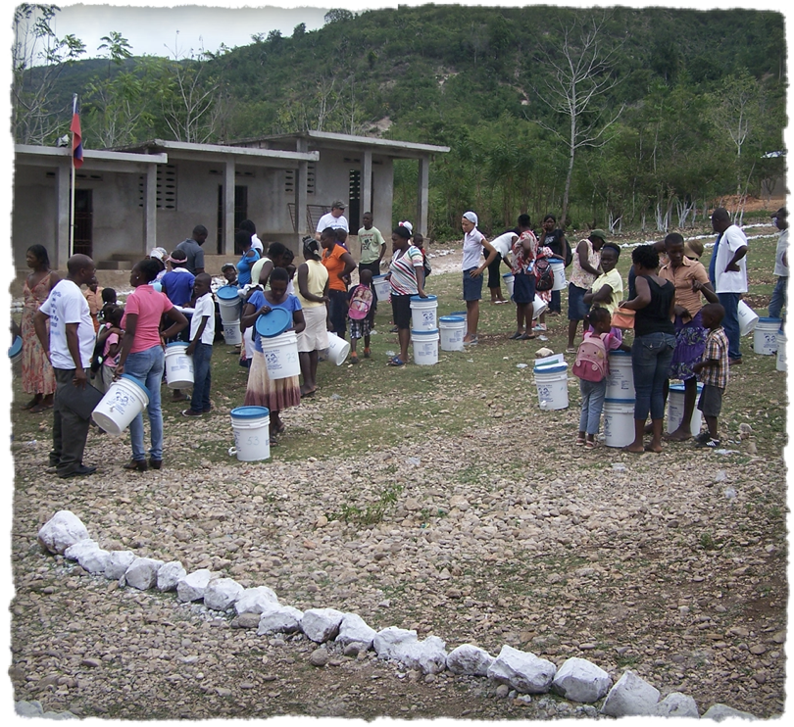
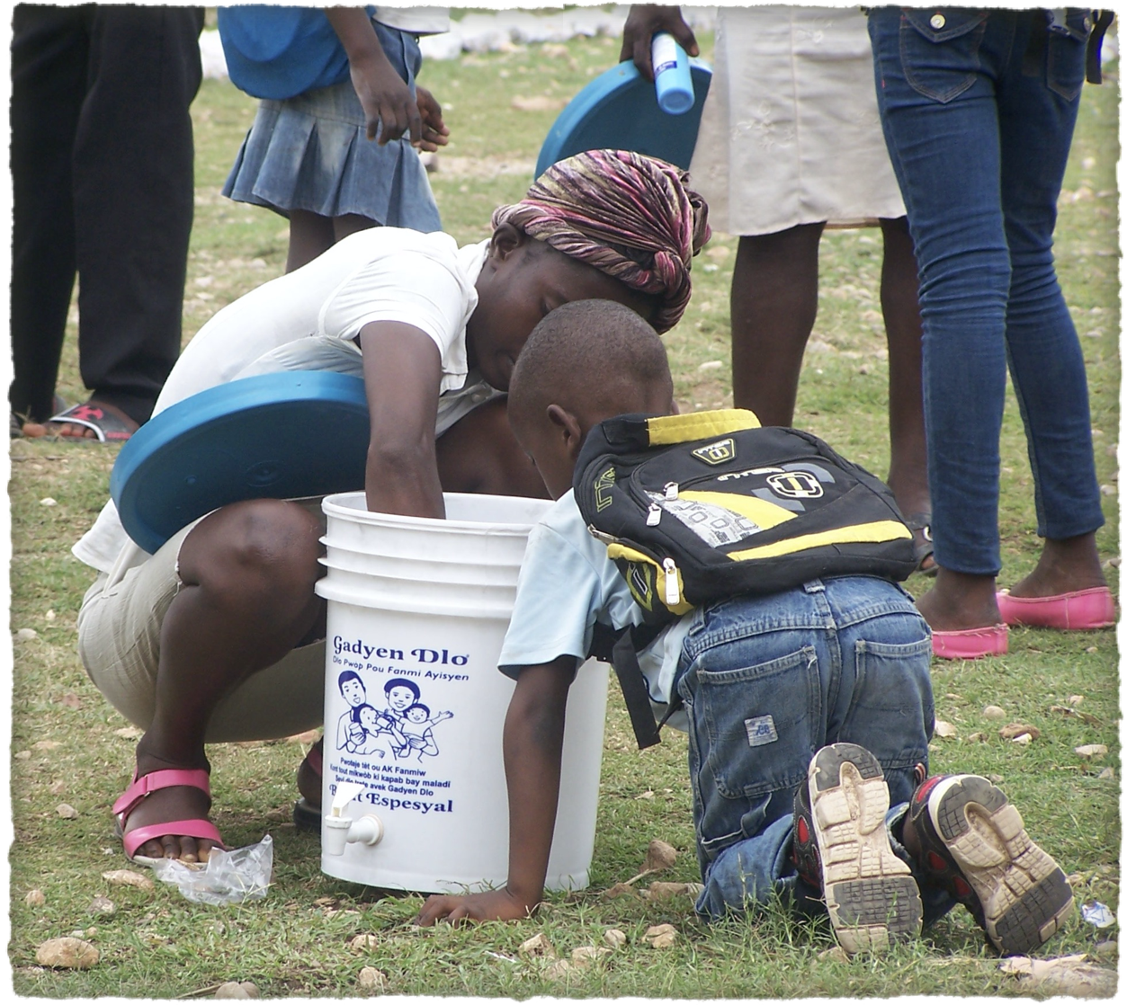
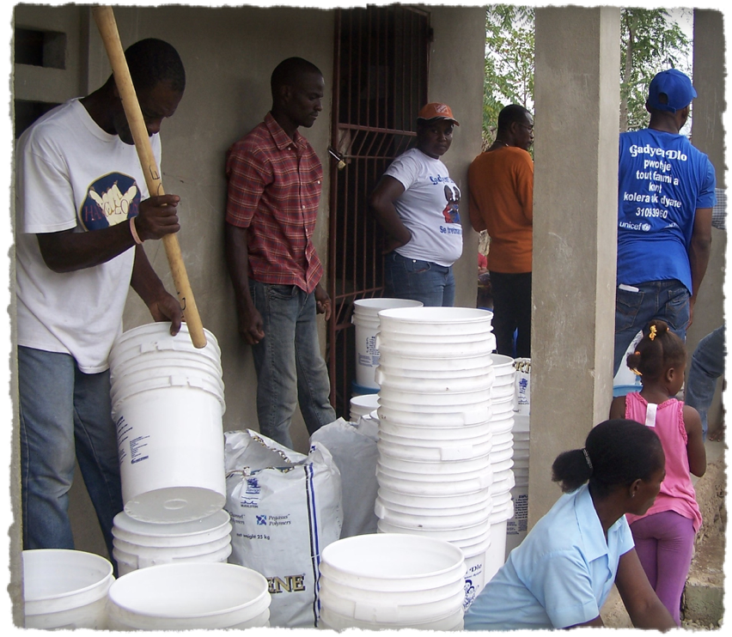
Distribution of the
water purification systems
to the Bercy community

Slide 14
New Well at the School
Blessing of the well by Fr. Coissy
Dedicated to Jack Kenny’s memory

Slide 15
“Tippy Tap” Hand Washing Stations

Slide 16
New Block of Latrines

Slide 17
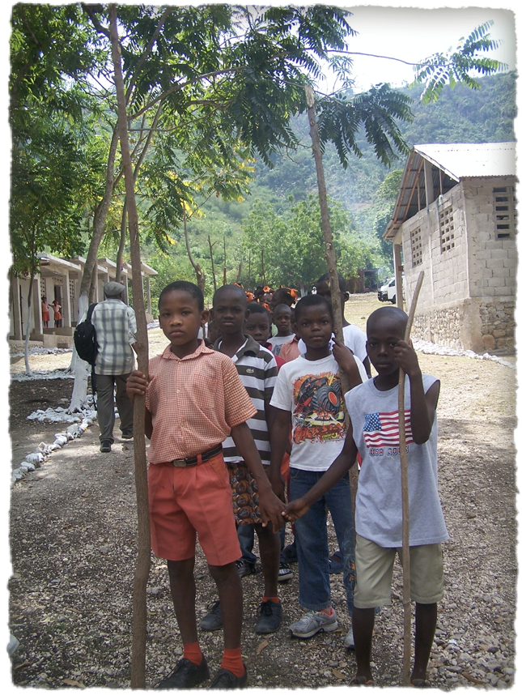
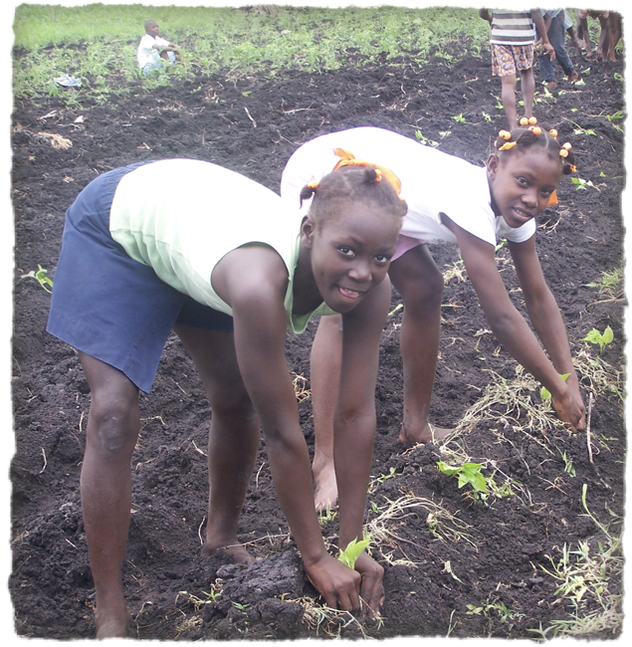
Garden Program
Grow food for the school lunches
Teach the children about farming
Provided oxen, plow, irrigation equipment, seeds, fertilizer

Slide 18
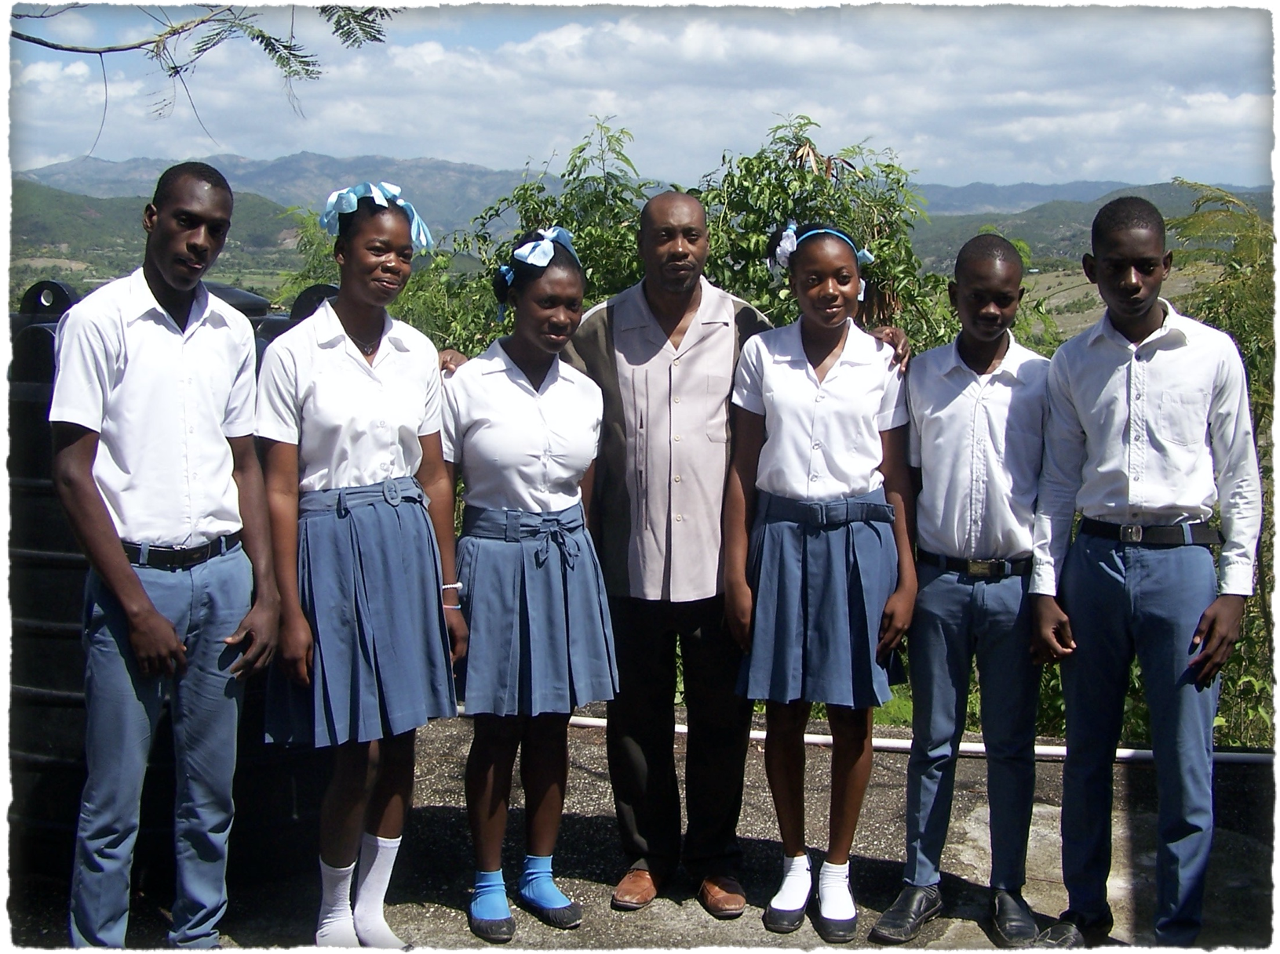
Bercy School Graduates are Succeeding
at Notre Dame High School in Cavaillon
We provide a very modest stipend to help offset tuition and transportation costs

Slide 19
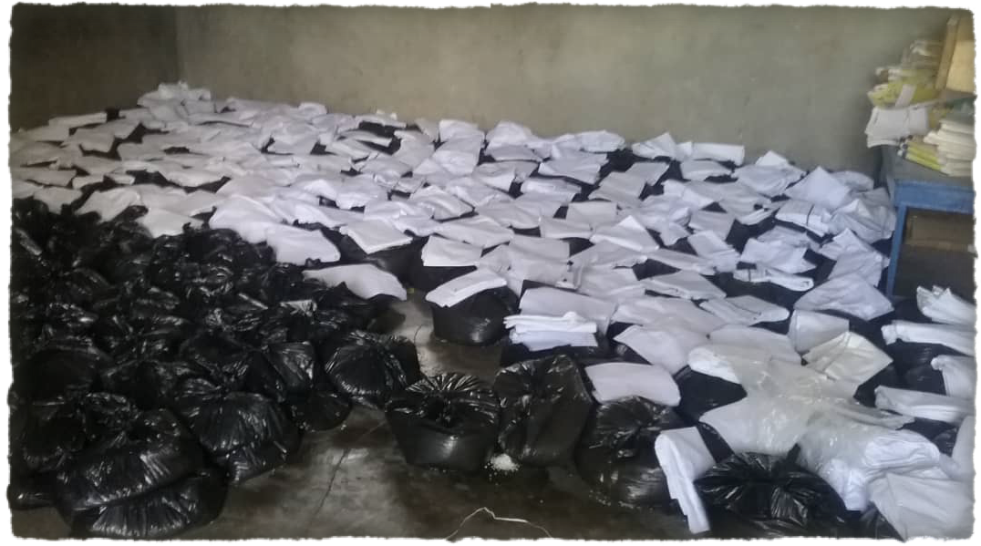
Life-Sustaining Help after August 2021 Earthquake
We were there for our friends when other help was very slow to arrive
Feeding the Bercy community at the school
Care packages with food and
other essentials for Bercy families

Slide 20
Bercy families who lost everything were sheltered at the school
Renewed supply of water purification systems to fight against cholera

Slide 21
Tarps (in Bercy orange!) provided shelter to local families

Slide 22
Bring Your Ideas and Energy
to the Haiti Committee
Represent and promote the Haiti Mission within the parish
Develop and help to implement new initiatives to raise program funds
Provide fiscal oversight for how donor funds are used
Provide hands-on help with donor communications
Contact Julie Schoenman if you would like to volunteer (jschoenman@comcast.net)

Slide 23
Support the Mission
Donations to the Haiti Mission may be made at any time:
Via a check made out to St. Thomas à Becket with Bercy School written in the memo line. Checks may be deposited in the Sunday collection or delivered in person or by mail to the parish office (1421 Wiehle Ave., Reston, VA 20190)
Via Faith Direct - Use the Bercy School, Haiti button under the Recurring Gifts option, or make a one-time donation designated for the Bercy School
Thank You!

